Slide 1

Introduction
21 February 2019
Computational physics
Lecture 1
Hai-Qing Lin
Beijing Computational Science Research Center
Notes:
先讲现在物理学中的三个主要分支：实验、理论和计算物理。然后具体介绍计算物理定义内涵以及产生和发展
发展规律特点
计算物理发展的扩大
计算内容以及方法的多样性
计算模拟与物理实验的对比以及其优势

Slide 2
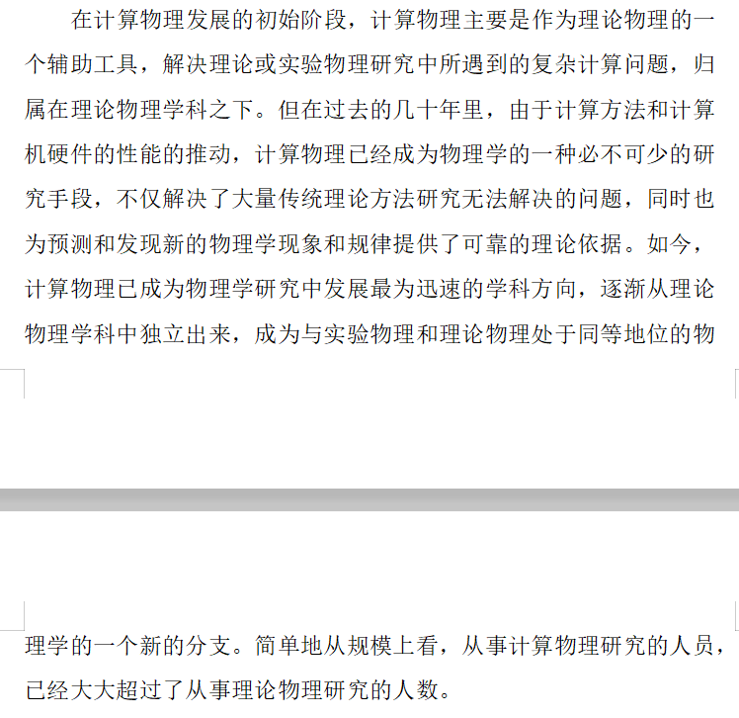
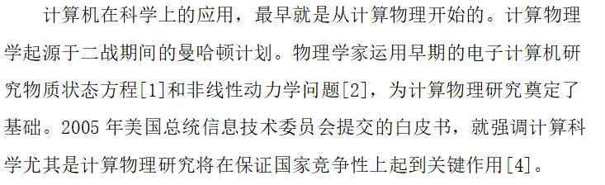
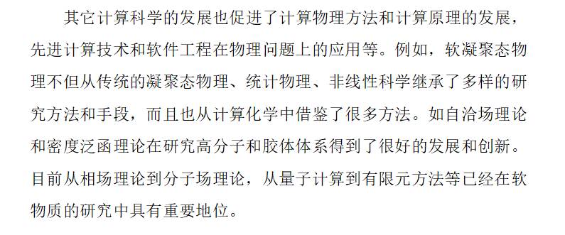
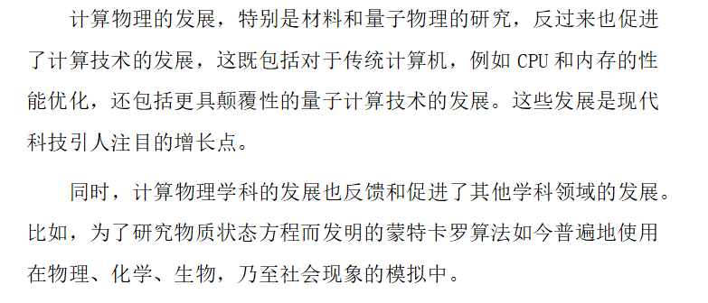
第一部分ppt的建议：思路方向以及构建顺序
先讲现在物理学中的三个主要分支：实验、理论和计算物理。然后具体介绍计算物理定义内涵以及产生和发展
发展规律特点（可以放摩尔定律以及超算平台的图）
计算物理发展的扩大（机器学习、神经网络学习）以及计算物理的发展与其他发展的相互作用
计算内容以及方法的多样性
计算模拟与物理实验的对比以及其优势点
计算机的发展为计算物理的发展提供基础。稍微提一下计算机（你的几张图）
发展历程

Slide 3
Introduction
Computational physics
Computational Physics
Theory
Experiment
Computer as tool
By means of computation method and software
To study and discover structure of matter and its laws of motion
The Golden Triangle: Theory, Experiment, and Computation
Notes:
先讲现在物理学中的三个主要分支：实验、理论和计算物理. 计算物理的定义：计算物理是以计算机为工具、计算方法和软件为手段，研究和发现物质结构及其运动规律的一门学科。

Slide 4
Introduction
Computational physics
Computational physics
originated from the Manhattan Project during World War II to study the material state equation and the nonlinear dynamics problem
an aid to theoretical physics in the initial stage
an indispensable research tool in the past few decades
Combines physics, computer science and applied mathematics.
Provides scientific solutions to real-world problems.
Employs common techniques to areas such as: Material design, Environmental modeling, Nuclear cleanup, Energy management, Medical imaging, Finance, AI…
Notes:
计算机在科学上的应用，最早就是从计算物理开始的。计算物理学起源于二战期间的曼哈顿计划。物理学家运用早期的电子计算机研究物质状态方程[1]和非线性动力学问题[2]，为计算物理研究奠定了基础。2005年美国总统信息技术委员会提交的白皮书，就强调计算科学尤其是计算物理研究将在保证国家竞争性上起到关键作用[4]。
在计算物理发展的初始阶段，计算物理主要是作为理论物理的一个辅助工具，解决理论或实验物理研究中所遇到的复杂计算问题，归属在理论物理学科之下。但在过去的几十年里，由于计算方法和计算机硬件的性能的推动，计算物理已经成为物理学的一种必不可少的研究手段，不仅解决了大量传统理论方法研究无法解决的问题，同时也为预测和发现新的物理学现象和规律提供了可靠的理论依据。如今，计算物理已成为物理学研究中发展最为迅速的学科方向，逐渐从理论物理学科中独立出来，成为与实验物理和理论物理处于同等地位的物理学的一个新的分支。简单地从规模上看，从事计算物理研究的人员，已经大大超过了从事理论物理研究的人数。

Slide 5
Introduction
Computational physics
Importance of Computers in Physics
Affect out thinking and learning process
The uses of computers
Numerical analysis: Solving linear equation, summation and integration, etc. The simplifying physical principles are discovered before computation.
Symbolic manipulation: quadratic equation, differentiation, integration, matrix inversion, power series expansion, etc.
Simulation: numerical experiments, testing models.
Collection and analysis of data: controlling experiments, curve fitting, forecasting, etc.
Visualization/Multimedia: important new development.
Quantum computing: future generation.
Notes:
计算机的发展为计算物理提供基础

Slide 6
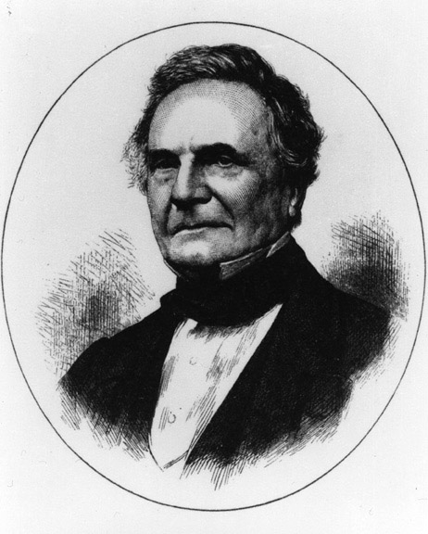
Introduction
Computational physics
Computer History
Charles Babbage
(1791 - 1871), the Analytical invented Engine, a mechanical digital computer which anticipated virtually every aspect of present-day computers.
1821, concept of DE1
1847, design of DE2
(fail to construct)
Notes:
计算机在科学上的应用，最早就是从计算物理开始的。计算物理学起源于二战期间的曼哈顿计划。物理学家运用早期的电子计算机研究物质状态方程[1]和非线性动力学问题[2]，为计算物理研究奠定了基础。2005年美国总统信息技术委员会提交的白皮书，就强调计算科学尤其是计算物理研究将在保证国家竞争性上起到关键作用[4]。

Slide 7
Introduction
Computational physics
Babbage’s Difference Engine No.1(DE1)
This wood cut depicts a trial piece of the DE1, built in1833.
ommenced 1823.
Commenced 1823
put together 1833
Abandoned 1842.
The plate was printed in June 1853.
Exhibition 1862.
Notes:
Charles Babbage began to construct a small difference engine in c. 1819^{[4]} and had completed it by 1822 (Difference Engine 0).^{[5]} He announced his invention on June 14, 1822, in a paper to the Royal Astronomical Society, entitled "Note on the application of machinery to the computation of astronomical and mathematical tables".^{[6]} This machine used the decimal number system and was powered by cranking a handle. The British government was interested, since producing tables was time-consuming and expensive and they hoped the difference engine would make the task more economical.^{[7]}
In 1823, the British government gave Babbage £1700 to start work on the project. Although Babbage's design was feasible, the metalworking techniques of the era could not economically make parts in the precision and quantity required. Thus the implementation proved to be much more expensive and doubtful of success than the government's initial estimate. In 1832, Babbage and Joseph Clement produced a small working model (1/7 of the calculating section of Difference Engine No. 1,^{[5]} which was intended to operate on 20-digit numbers and sixth-order differences) which operated on 6-digit numbers and second-order differences.^{[8][9]} Lady Byron described seeing the working prototype in 1833: "We both went to see the thinking machine (for so it seems) last Monday. It raised several Nos. to the 2nd and 3rd powers, and extracted the root of a Quadratic equation."^{[10]} Work on the larger engine was suspended in 1833.
By the time the government abandoned the project in 1842,^{[9][11]} Babbage had received and spent over £17,000 on development, which still fell short of achieving a working engine. The government valued only the machine's output (economically produced tables), not the development (at unknown and unpredictable cost to complete) of the machine itself. Babbage did not, or was unwilling to, recognize that predicament.^{[7]} Meanwhile, Babbage's attention had moved on to developing an analytical engine, further undermining the government's confidence in the eventual success of the difference engine. By improving the concept as an analytical engine, Babbage had made the difference engine concept obsolete, and the project to implement it an utter failure in the view of the government.^{[7]}
The incomplete Difference Engine No. 1 was put on display to the public at the 1862 International Exhibition in South Kensington, London.^{[12][13]}

Slide 8
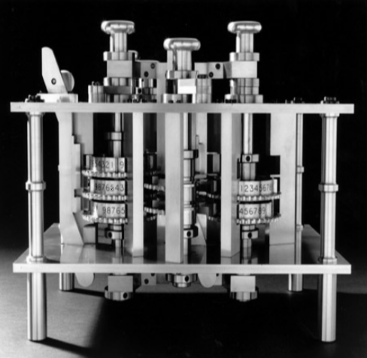
Introduction
Computational physics
Babbage’s Difference Engine No.2(DE2)
Between 1847 and 1849 Babbage designed, but did not build, the DE2. The Science Museum, London, constructed it in 1991, using Babbage’s original designs.
(Photograph courtesy of the Science Museum of London.)
Notes:
Charles Babbage began to construct a small difference engine in c. 1819^{[4]} and had completed it by 1822 (Difference Engine 0).^{[5]} He announced his invention on June 14, 1822, in a paper to the Royal Astronomical Society, entitled "Note on the application of machinery to the computation of astronomical and mathematical tables".^{[6]} This machine used the decimal number system and was powered by cranking a handle. The British government was interested, since producing tables was time-consuming and expensive and they hoped the difference engine would make the task more economical.^{[7]}
In 1823, the British government gave Babbage £1700 to start work on the project. Although Babbage's design was feasible, the metalworking techniques of the era could not economically make parts in the precision and quantity required. Thus the implementation proved to be much more expensive and doubtful of success than the government's initial estimate. In 1832, Babbage and Joseph Clement produced a small working model (1/7 of the calculating section of Difference Engine No. 1,^{[5]} which was intended to operate on 20-digit numbers and sixth-order differences) which operated on 6-digit numbers and second-order differences.^{[8][9]} Lady Byron described seeing the working prototype in 1833: "We both went to see the thinking machine (for so it seems) last Monday. It raised several Nos. to the 2nd and 3rd powers, and extracted the root of a Quadratic equation."^{[10]} Work on the larger engine was suspended in 1833.
By the time the government abandoned the project in 1842,^{[9][11]} Babbage had received and spent over £17,000 on development, which still fell short of achieving a working engine. The government valued only the machine's output (economically produced tables), not the development (at unknown and unpredictable cost to complete) of the machine itself. Babbage did not, or was unwilling to, recognize that predicament.^{[7]} Meanwhile, Babbage's attention had moved on to developing an analytical engine, further undermining the government's confidence in the eventual success of the difference engine. By improving the concept as an analytical engine, Babbage had made the difference engine concept obsolete, and the project to implement it an utter failure in the view of the government.^{[7]}
The incomplete Difference Engine No. 1 was put on display to the public at the 1862 International Exhibition in South Kensington, London.^{[12][13]}

Slide 9
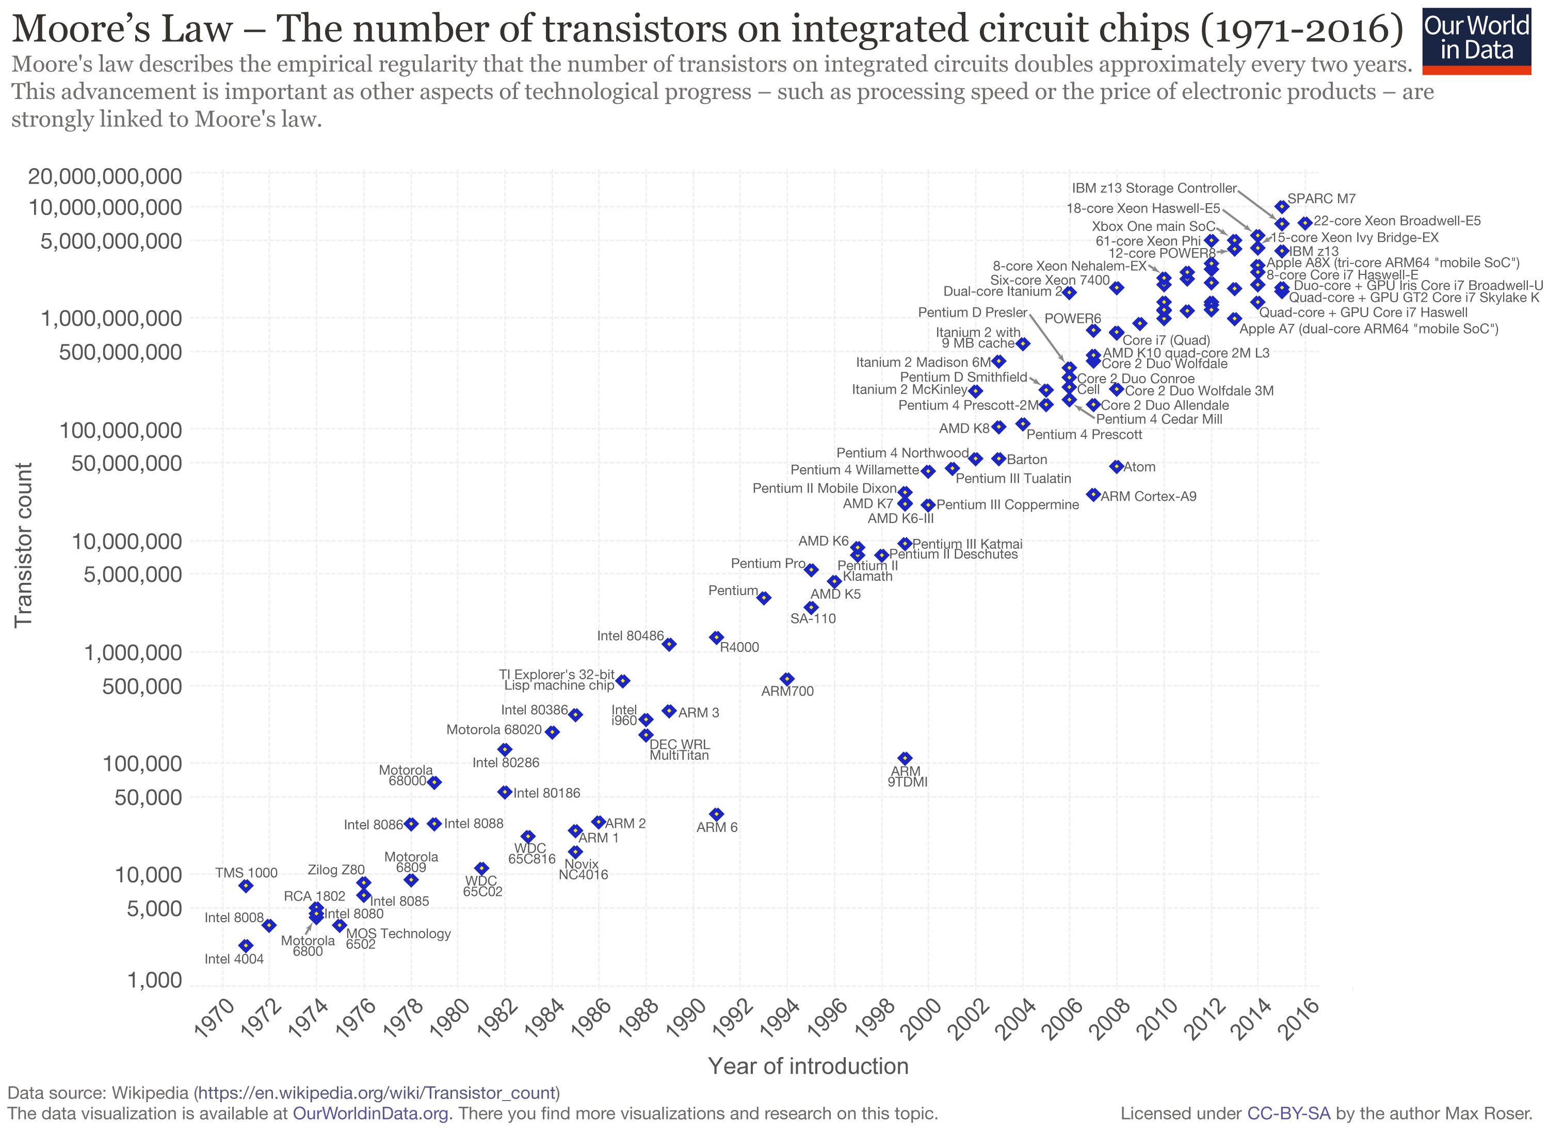
Introduction
Computational physics
Moore’s Law
Doubling every two years
Notes:
Moore's law is the observation that the number of transistors in a dense integrated circuit doubles about every two years.

Slide 10
Introduction
Computational physics
A Brief History of Computers
Machine | Year | Speed(in Flops)
ENI-AC | 1946 | 0.36K
IBM 70 | 1954 | 12K
CDC 6600 | 1966 | 4.6M
CRAY 1 | 1976 | 50M
CRAY X/MP, Y/MP, C90, T3E | 1983 | 166M-1.5T
C-2/200, CM-5(1024 nodes) | 1989 | 1.2T
Intel Paragon (128 nodes) | 1991 | 10G
IBM SP-2 (64 nodes) | 1994 | 17G
P6/Sandia (9072) | 1996 | 1.2T
IBM RS/6000 SP 2002 | 2002 | 100G
TH2-JK RS/6000 SP | 2015 | 809T*
*: Supercomputers at CUHK, CSRC

Slide 11
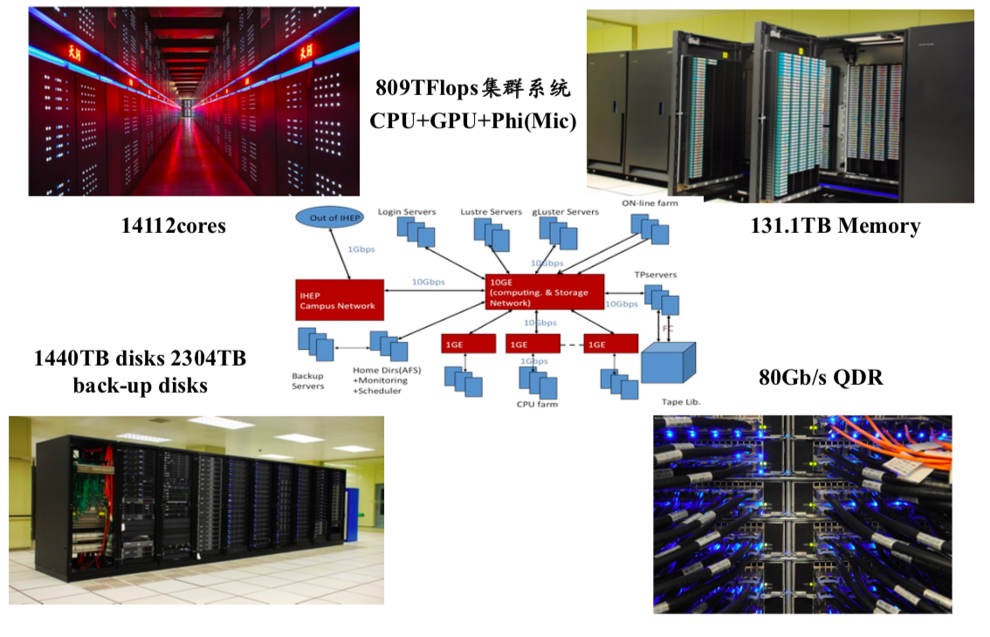
Introduction
Computational physics
TH2-JK

Slide 12
Introduction
Computational physics
TOP 10 Sites for November 2018
Rank | System | Cores | Rmax (TFlop/s) | Rpeak (TFlop/s) | Power (kW)
1 | Summit IBM | 2,397,824 | 143,500.00 | 200,794.90 | 9,783
2 | Sierra | 1,572,480 | 94,640.00 | 125,712.00 | 7,438
3 | Sunway TaihuLight | 10,649,600 | 93,014.60 | 125,435.90 | 15,371
4 | Tianhe-2A | 4,981,760 | 61,444.50 | 100,678.70 | 18,482
5 | Piz Daint | 387,872 | 21,230.00 | 27,154.30 | 2,384
6 | Trinity | 979,072 | 20,158.70 | 41,461.20 | 7,578
7 | ABCI | 391,680 | 19,880.00 | 32,576.60 | 1,649
8 | SuperMUC-NG | 305,856 | 19,476.60 | 26,873.90
9 | Titan | 560,640 | 17,590.00 | 27,112.50 | 8,209
10 | Sequoia | 1,572,864 | 17,173.20 | 20,132.70 | 7,890
Notes:
Summit widened its lead as the number one system, improving its High Performance Linpack (HPL) performance from 122.3 to 143.5 petaflops since its debut on the previous list in June 2018.
Tianhe-2A (Milky Way-2A), deployed at the National Supercomputer Center in Guangzho, China, is now in the number four position with a Linpack score of 61.4 petaflops. It was upgraded earlier this year by China’s National University of Defense Technology (NUDT), replacing the older Intel Xeon Phi accelerators with the proprietary Matrix-2000 chips.

Slide 13
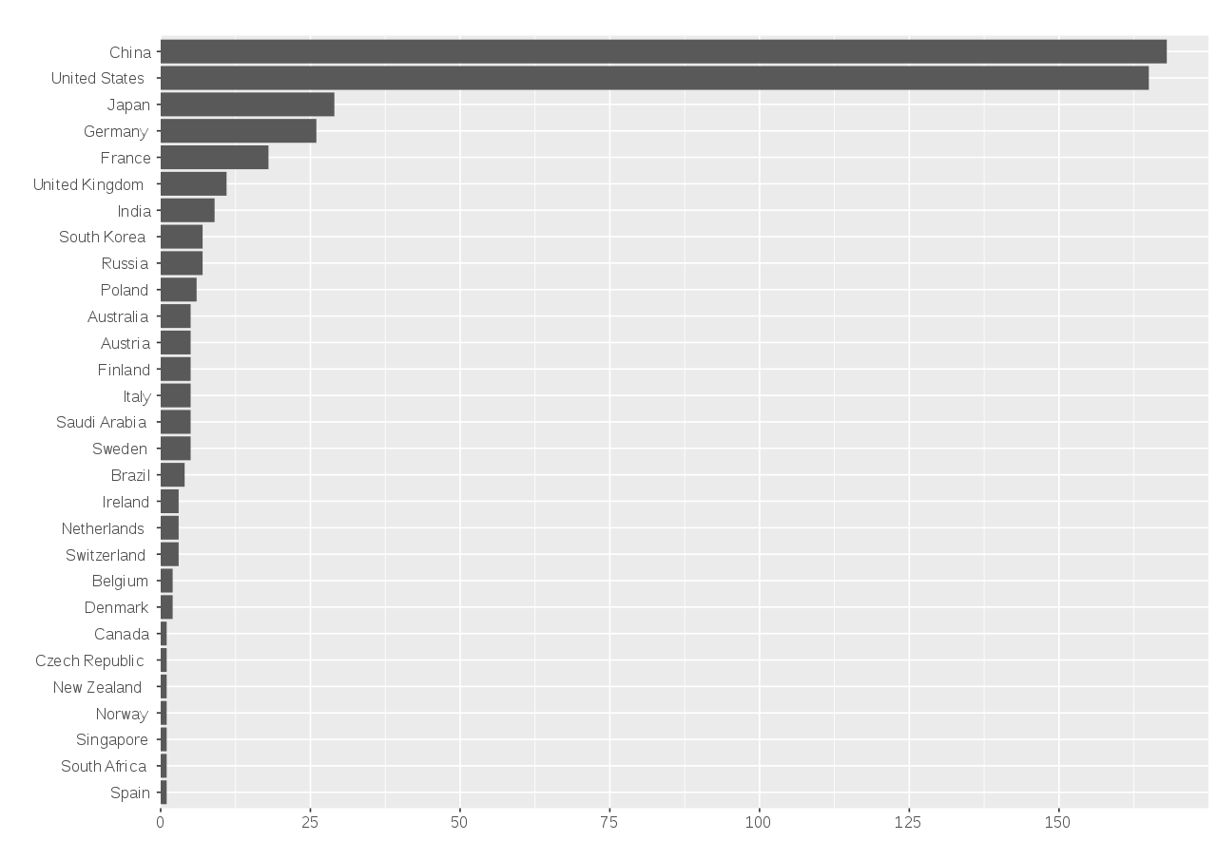
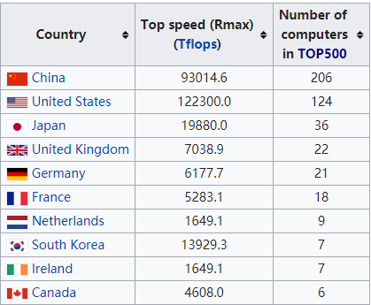
Introduction
Computational physics
Up to June 2018
Distribution of supercomputers in the TOP500 list by country, June 2016.
Notes:
500强超算中，中国占据29.3%比例，位列第二。
China operates a number of supercomputer centers which, altogether, hold 29.3% performance share of world's fastest 500 supercomputers.
The origins of these centers go back to 1989, when the State Planning Commission, the State Science and Technology Commission and the World Bank jointly launched a project to develop networking and supercomputer facilities in China. In addition to network facilities, the project included three supercomputer centers.^{[3]} China's Sunway TaihuLight ranks Third in the TOP500list.
As of 2018, China dominated the globe's highest performance machines list with 206 out of the top 500 fastest supercomputers in the world, exceeding the second placing (United States) which had 124

Slide 14
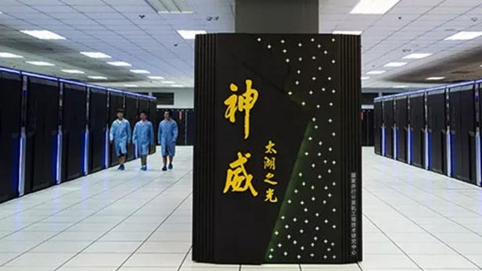
Introduction
Computational physics
Sunway TaihuLight
the world's fastest supercomputer for two years, from June 2016 to June 2018
nearly three times as fast as the previous Tianhe-2, which ran at 34 petaflops.
1.45 GHz (3.06 TFlops single CPU, 105 PFLOPS LINPACK, 125 PFLOPS peak)
10,649,600 CPU cores
20PB storage

Slide 15
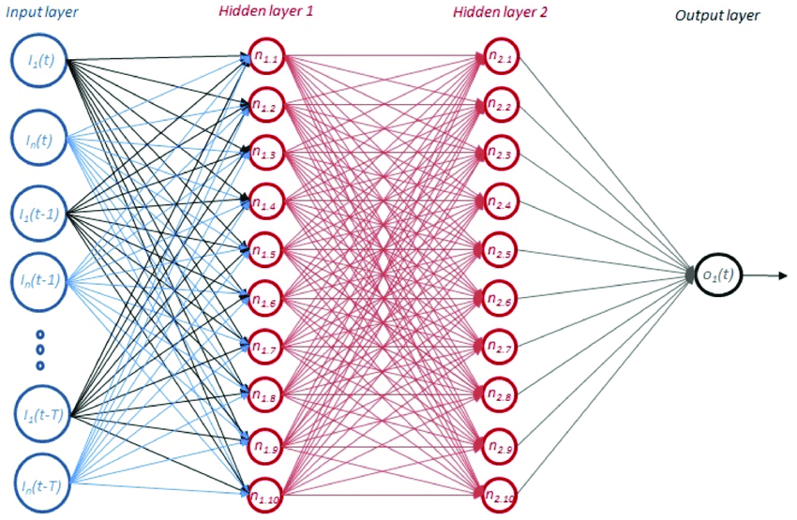
Introduction
Computational physics
Machine Learning
Use machine learning methods to design materials and chemical molecules, accelerating the discovery of materials and drugs
Judge and characterize a phase transition, serve as a quantum many-body wave function or the like.
The combination of the machine learning methods and traditional methods
Notes:
近年来，机器学习和人工智能领域的进展也逐渐渗透到计算物理研究中。比如使用机器学习方法进行材料和化学分子的设计，以加速材料与药物的发现。还比如使用深层神经网络判断和刻画相变、或作为量子多体波函数等。除了直接的应用之外，机器学习方法和传统的方法的深度结合也是具有潜力的研究生长点。

Slide 16
Introduction
Computational physics
Application fields in physics
Cosmology
Particle physics
Nuclear physics
Plasma physics
Condensed matter physics
Optics
Atomic and molecular physics
Notes:
计算物理是以计算机为工具、计算方法和软件为手段，研究和发现物质结构及其运动规律的一门学科。其研究范围涵盖了物理学的所有子领域，从微观世界的基本粒子，到广阔无垠的宇宙；从10-22秒的超快事件，到大爆炸以来宇宙的一百多亿年的演变过程；从接近绝对零度的超冷原子，到上亿度的热核聚变和超高温天体，包括宇宙学、粒子物理、核物理、等离子体物理、凝聚态物理、光学、原子分子物理二级学科等，在物理学的发展中发挥着不可或缺的作用。
物理学研究的对象小到微观基本粒子，大到广阔无垠的宇宙，从瞬息即变超快过程，到大爆炸以来宇宙的演变过程，从接近绝对零度的超冷原子，到上亿度的热核聚变，涉及大跨度范围的参数的变化，多时空尺度物理过程和集体效应往往同时存在于相关物理过程，包括波与波、波与粒子、粒子与粒子的相互作用，不同的物理过程在时空上相互耦合。针对这些不同尺度、不同时间、不同温度、不同压力的研究对象，研究方法自然也会有很大的不同。

Slide 17
Introduction
Computational physics
Computer Simulation
restore the description and simulation of the nature of objective things.
no measurement error, systematic error and no interference problem of the test probe
free selection parameters
plays a role in matching and even leading experimental physics
Notes:
计算物理由于利用了现代计算机的大存储量和快速计算能力，可以多考虑一些因素，可以模拟动态过程，可以保持非线性特性，可以保留变系数特点，可以考虑较复杂的边界条件等，因此能恢复对客观事物本质的描述和模拟。
计算模拟不存在物理实验中的测量误差和系统误差，没有测试探头的干扰问题，还可以比较自由的选取参数，比物理实验有更大的自由度和灵活性。和安全性。

Slide 18
Introduction
Computational physics
Sub-fields
Statistical physics
Condensed matter physics
Soft condensed matter physics
Atomic and molecular physics
Nuclear physics
High energy physics
Plasma physics
Notes:
分领域的发展规律和特点：
统计物理
凝聚态物理
软凝聚态物理
原子与分子物理
核物理
高能物理
等离子体物理

Slide 19
Introduction
Computational physics
1. Statistical Physics: Monte Carlo methods
How to measure the area？
19
Notes:
计算统计物理学是计算物理学最早发展起来的学科分支。一般认为，1953年Metropolis提出Monte Carlo算法，并应用于简单统计模型的固液相变模拟，是先驱的研究工作，而该算法后来被人们命名为Metropolis算法。一直以来，Monte Carlo算法和分子动力学模拟，是计算统计物理学的主要计算方法。50年代至70年代初，Monte Carlo模拟主要应用于相变的初步研究 。70年代后，随着集成电路的发展，计算机的计算能力大大提高。基于连续相变的有限尺寸标度理论，人们开始进行大规模的Monte Carlo模拟。同的研究思路。进入80年代，一方面，关注相变研究中的临界慢化困难，另一方面，提出和发展量子Monte Carlo模拟 的各种算法。

Slide 20
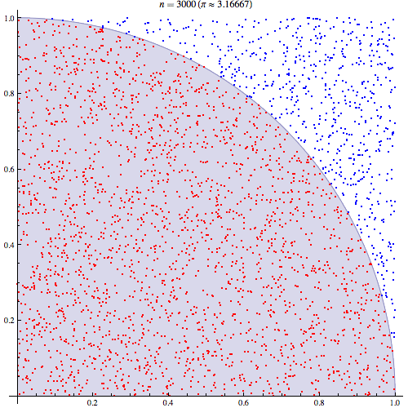
Introduction
Computational physics
How to calculate π？
When N₂=30000，the relative bias of π is only 0.07%
Notes:
蒙特卡罗(Monte Carlo, MC)方法又名随机模拟法或统计试验法。它是在第二次世界大战期间兴起和发展起来的。它的奠基人是冯.诺依曼(Von Neumann)。其主要思想是在计算机上模拟实际概率过程，然后加以统计处理。该方法与传统数学方法相比，具有直观性强、简便易行的优点，它能处理一些其它方法所不能的复杂问题，并且容易在计算机上实现。 可以采用蒙特卡罗方法解决的问题分为两类，一类是问题本身具有概率或随机事件背景，可以直接用蒙特卡罗随机试验模拟；另一类是问题本身是确定性问题，需要通过构造随机事件来逼近真实情景。

Slide 21
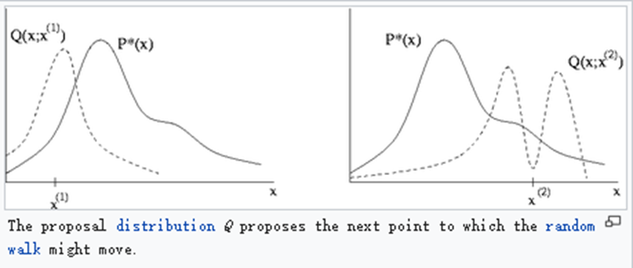
Metropolis algorithm
Introduction
Computational physics
Notes:
In statistics and statistical physics, the Metropolis–Hastings algorithm is a Markov chain Monte Carlo (MCMC) method for obtaining a sequence of random samples from a probability distribution from which direct sampling is difficult.
This sequence can be used to approximate the distribution or to compute an integral.
Metropolis–Hastings and other MCMC algorithms are generally used for sampling from multi-dimensional distributions, especially when the number of dimensions is high.

Slide 22
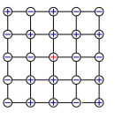
Metropolis algorithm in Ising model
Select one of the spins in the form Γ = (s₁, s₂, ··· , s_{i},··· , s_{N}) , like s_{i}.
Flip it, Γ’ = (s₁,s₂,··· ,−s_{i},··· , s_{N}). Choose a new configuration according to attempt probability 1/N
Calculate ∆E = E(Γ’)−E(Γ), and get ratio W(Γ’)/W(Γ) = e^{−∆E/kBT}
Set up P_{accept}(Γ’,Γ) = min[W(Γ’)/W(Γ) ,1]:
if ∆E ≤ 0, accept Γ’;
if ∆E > 0, accept Γ’ as probability e^{−∆E/kBT} ;otherwise, reject.
back to step 1 to generate enough configuration.
Notes:
1 在位形Γ = (s1,s2,··· ,si,··· ,sN)中任选一个 自旋，比如si.
2 翻转它，Γ0 = (s1,s2,··· ,−si,··· ,sN). 这就是 按pattempt = 1 N 的几率选择一个新位形
3 计算∆E = E(Γ0)−E(Γ), 得到 W(Γ0) W(Γ) = e−∆E/kBT
4 设定Paccept(Γ0,Γ) = min[W(Γ0) W(Γ) ,1]： I 如果∆E ≤ 0, 接受Γ0; I 如果∆E > 0, 按几率e−∆E/kBT接受Γ0; 否则拒 绝Γ0(或者说取Γ0 = Γ).
5 回到1, 循环到足够的位形产生.
I Paccept也可以选为热浴(Heat Bath)法： Paccept(Γ0,Γ) = e−E(Γ0)/kBT e−E(Γ0)/kBT + e−E(Γ)/kBT = 1 1 + e∆E/kBT

Slide 23
Clustering
Introduction
Computational physics
Group a set of objects which are more similar (in some sense) to each other than to those in other groups (clusters).
A common technique for statistical data analysis used in many fields:
machine learning
pattern recognition
image analysis
information retrieval
Bioinformatics
data compression
computer graphics.
Notes:
1987年，Swendsen和Wang首次构造非局域的Monte Carlo算法，即所谓的Cluster算法，这是Monte Carlo算法的一个里程碑，在极大程度上减弱临界慢化困难。1989年提出的Wolff算法，更简单实用。 但是，Cluster算法不具有普适性，不同相互作用系统需要构造不同算法。至今，无序阻挫系统、规范场理论等仍然缺少真正有效的Cluster算法。此外，人们先后发展了若干其他有效算法，比如，Hybrid 算法，是不同的Monte Carlo算法和分子动力学模拟的结合； Multigrid 算法，提出可变自旋块的数值模拟；而Monte Carlo重正化群方法则留下粗粒化的数值模拟思路。在远离平衡态动力学过程的数值模拟方面，80年代起也取得实质性进展，如相分离动力学、液体和合金混合动力学，自旋玻璃和无序系统动力学，界面、表面、畴壁动力学，各向异性的KPZ方程，化学反应动力学，以及各种类型的非平衡态动力学相变。特别是，自组织临界现象的发现引起广泛的关注，形成的研究热点长盛不衰，是非平衡态统计物理的一个里程碑。

Slide 24
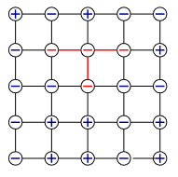
Wolff algorithm
Introduction
Computational physics
Flip a group in one step instead of flipping N = L^{d} one by one step:
Choose a spin i arbitrarily
Turn s’_{i} = −s_{i}
Do the following for all nearest neighbors of i: If s_{k} = s_{i}, the probability is 1−e^{−2K}, K = J/k_{B}T
turn s_{k} → s’_{k} = −s_{k}
Record k to the address list (stack)
If s_{k} = s’_{i}, do nothing
Read an address l from the stack
Perform step 3 on l
Remove l from the stack
Repeat 4-6 until the stack is empty

Slide 25
Quantum Monte Carlo
Introduction
Computational physics
aim to study complex quantum systems.
provide a reliable solution (or an accurate approximation) of the quantum many-body problem.
going beyond mean field theory
offering an exact solution of the many-body problem in some circumstances.

Slide 26
Other algorithms
Introduction
Computational physics
Hybrid algorithm
Multigrid algorithm
Monte Carlo renormalization group method
Notes:
Hybrid algorithm
an algorithm that combines two or more other algorithms that solve the same problem, either choosing one (depending on the data), or switching between them over the course of the algorithm.
Multigrid algorithm
algorithms for solving differential equations using a hierarchy of discretizations.
Monte Carlo renormalization group method
the renormalization group (RG) refers to a mathematical apparatus that allows systematic investigation of the changes of a physical system as viewed at different scales.

Slide 27
Introduction
Computational physics
2. Condensed matter physics
Semiconductor Physics
Magnetics
Strong Association Physics
Surface Physics
Soft Condensed Physics
Two methods:
First-Principles method (Condensed matter calculation I )
Model Hamiltonian method (Condensed matter calculation II）
Notes:
凝聚态物理是物理学乃至整个物质科学最大的一个分支，也是物理学近半个世纪以来发展最为迅速的一个领域。凝聚态物理涵盖面很广，按学科分类，包括半导体物理、磁学、强关联物理、表面物理、软凝聚态物理等子领域。传统上，针对凝聚态物理问题的研究一般可分为理论研究与实验研究两大方面。
依据计算模拟中所用到的哈密顿量的不同，凝聚态计算可分为基于第一性原理方法与基于模型哈密顿量方法两种。前者（凝聚态计算I）注重发展研究材料各种性质的普适方法，在预见性方面具有不可比拟的优势，但是如果体系存在很强的多体效应，如强电子关联，目前的第一性原理方法还不能准确描述其中的主要过程。这时，针对特定的体系后者（基于模型哈密顿量方法的电子结构计算，即凝聚态计算II）可为前者提供强有力的补充，得到与实验一致的结果。

Slide 28
Introduction
Computational physics
Condensed matter calculation I
Based on First-principles Calculation of Electronic structure and dynamic Simulation .
The description of electronic structure strictly includes density functional theory (Density-Functional Theory, DFT), post-Hartree-Fock method and Quantum Monte Carlo method.
At present, in the first principle simulation technology of the condensed matter , the method of the electronic structure layer refers to the DFT.
Notes:
计算凝聚态物理I，即基于第一性原理的电子结构计算与动力学模拟，其电子结构的描述严格意义上包括密度泛函理论(Density-Functional Theory, DFT)、post-Hartree-Fock方法、与量子蒙特卡洛方法。由于post-Hartree-Fock方法和量子蒙特卡洛方法在处理大体系时对计算量的超级需求，在目前我们讲到的凝聚态领域第一性原理模拟技术中，电子结构层面的方法多指DFT。

Slide 29
Introduction
Computational physics
Condensed matter calculation I
The research in this area:
1)the processing of the exchange association interaction of the electronic structure in the development of the method, study on the properties of excited states of electron, the development of algorithms and programs and their possible applications in complex Large-Scale systems, study on dynamics and statistical methods.
2) application level from structural analysis to physical properties prediction, and to material precise design and so on.
Notes:
近年来，随着该方面研究工作框架的初步建立，逐渐涌现出：
1）方法发展层面电子结构交换关联相互作用的处理、电子激发态性质的研究、算法与程序的发展及其在复杂大系统中可能的应用、动力学与统计方法的研究；
2）应用层面从结构解析、到物性预测、最终到材料精确设计等热点领域。

Slide 30
Introduction
Computational physics
Condensed matter calculation II
Belong to the category of many-body and strong correlation physics in condensed matter physics
Explain some novel phenomena： Integer and Fractional Quantum Hall effect ；High temperature superconductivity；Colossal magnetoresistance；Quantum phase transition；Magnetic frustration；Kondo effect；Heavy fermion behavior；Giant thermoelectric effect；Giant nonlinear optical effect
Strong correlation and quantum fluctuation
Numerical Renormalization Group and Quantum Monte Carlo methed
Notes:
计算凝聚态物理II, 属于凝聚态物理学中的多体和强关联物理学范畴。近二十年来，随着大量新的量子材料的合成和发现，一系列新奇的量子现象被揭示了出来，例如整数与分数量子霍尔效应、高温超导电性、庞磁电阻、量子相变、磁阻挫、近滕效应和重费米子行为、以及巨热电效应、巨非线性光学效应等。这些新的物理现象大都来源于这些系统中电子的电荷、自旋、轨道和晶格等微观自由度之间的共存与竞争，外界参量的微小变化往往就可能导致系统在不同量子态之间的转换，产生巨大的物性变化。这些现象不能在已有的固体理论框架下得到解释，新的固体量子理论框架的建立已迫在眉睫。这正是凝聚态理论发展的一个关键时期，也是凝聚态理论研究的一个机遇期
关联量子现象通常出现在低维系统中，粒子之间的相互作用与量子涨落效应都很强，给这方面的研究带来了很大的困难
计算凝聚态物理 II 涵盖以统计模型和相互作用量子模型为研究对象的多体计算方法，包括数值重正化群和量子蒙特卡罗方法等。

Slide 31
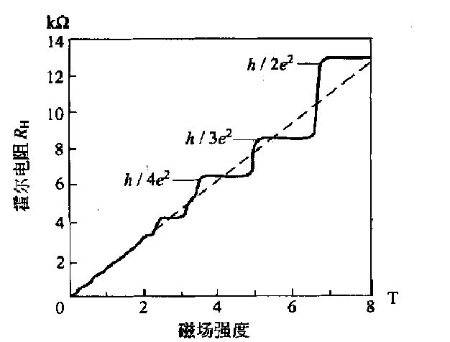
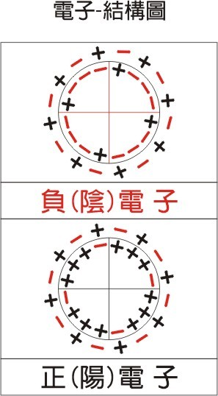
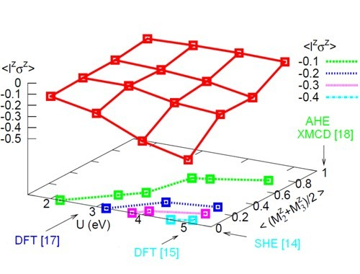
Introduction
Computational physics
Condensed matter calculation II
kondo effect
integer quantum Hall effect
Fractional Quantum Hall Effect
Notes:
计算凝聚态物理II, 属于凝聚态物理学中的多体和强关联物理学范畴。近二十年来，随着大量新的量子材料的合成和发现，一系列新奇的量子现象被揭示了出来，例如整数与分数量子霍尔效应、高温超导电性、庞磁电阻、量子相变、磁阻挫、近滕效应和重费米子行为、以及巨热电效应、巨非线性光学效应等。这些新的物理现象大都来源于这些系统中电子的电荷、自旋、轨道和晶格等微观自由度之间的共存与竞争，外界参量的微小变化往往就可能导致系统在不同量子态之间的转换，产生巨大的物性变化。这些现象不能在已有的固体理论框架下得到解释，新的固体量子理论框架的建立已迫在眉睫。这正是凝聚态理论发展的一个关键时期，也是凝聚态理论研究的一个机遇期
关联量子现象通常出现在低维系统中，粒子之间的相互作用与量子涨落效应都很强，给这方面的研究带来了很大的困难
计算凝聚态物理 II 涵盖以统计模型和相互作用量子模型为研究对象的多体计算方法，包括数值重正化群和量子蒙特卡罗方法等。

Slide 32
Introduction
Computational physics
Numerical Renormalization Group Method
proposed by K. G. Wilson in 1970s, and successfully used to solve Kondo problem
extended to the numerical solution of lattice model in real space in the following years (but the result error increases rapidly with the increase of lattice points)
Refined by Xiangtao in 1992 to reduce result error(only one lattice point was added at a time)
Proposed density matrix renormalization group(DMRG) White.
DMRG in momentum space, Transport Matrix Renormalization Group, Quantum Chemistry DMRG, Time-dependent DMRG, Dynamic DMRG
DMRG in Two-Dimensional Systems.
Notes:
数值重正化群方法是上世纪70年代K. G. Wilson在研究统计模型时提出的数值方法，并被Wilson成功用于解决近藤问题。随后几年，该方法被推广至实空间格点模型的数值求解，但计算结果随着格点的增加误差很快增大，甚至得到不正确的结果。这些问题的存在，引导当时的青年学者如美国的S. R. White和中国的向涛等对这些问题的进一步探索。向涛等在1992年发现，在数值重正化群框架下，一次只增加一个格点，结果误差迅速降低【T. Xiang and G. A. Gehring, J. Mag. Mag. Mat. 104-107, 861 (1992).】，给进一步拓展数值重正化群算法带来契机。随后，White提出密度矩阵重正化化群算法【S. R. White, Phys. Rev. Lett. 69, 2863 (1992); Phys. Rev. B 48, 10345 (1993).】，在一次增加一个格点的基础上，创造性地提出了使用密度矩阵的本征值的大小作为对目标态的贡献度的大小来判断需要保留的状态，从而达到控制误差的目的。该方法一经提出，迅速得到推广应用，并提出各种变化版本，如动量空间密度矩阵重正化群算法【T. Xiang, Phys. Rev. B 53, 10445 (1996).】、输运矩阵重正化群算法【T. Nishino, J. Phys. Soc. Jpn. 64, 3598 (1995)；R. J. Bursill, T. Xiang, and G. A. Gehring, J. Phys.: Condens. Matter 8, L583 (1996)；X. Q. Wang, and T. Xiang, Phys. Rev. B 56, 5061 (1997)；N. Shibata, J. Phys. Soc. Jpn. 66, 2221 (1997).】、量子化学密度矩阵重正化群算法【S. R. White and R. L. Martin, J. Chem. Phys. 110, 4127 (1998).】、时间相关密度矩阵重正化群算法【M. A. Cazalilla and J. B. Marston, Phys. Rev. Lett. 88, 256403 (2002)；H.-G.Luo, T. Xiang, and X. Q. Wang, Phys. Rev. Lett. 91, 049701 (2003).】以及动力学密度矩阵重正化群算法【E. Jeckelmann, Phys. Rev. B 66, 045114 (2002).】等。近十年，这些算法不断得到更新及更宽范围的应用【G. K. L. Chan and M. Head-Gordon, J. Chem. Phys. 118, 8551 (2003)；H.-G. Luo, M.-P. Qin, and T. Xiang，Phys. Rev. B 81, 235129 (2010)； G. Vidal, Phys. Rev. Lett., 93, 040502 (2004)；S. R. White, and A. E. Feiguin, Phys. Rev. Lett. 93, 076401 (2004); A. J. Daley, C. Kollath, U. Schollwöck, and G. Vidal, J. Stat. Mech.: Theor. Exp., P04005 (2004).】。随着计算机水平的提高，采取蛮力计算，密度矩阵重正化群算法也扩展二维系统，并对一些基本问题提供了建设性的结论【E.M. Stoudenmire and Steven R. White，Ann. Rev. Condens. Matter Phys. 3,111-128(2012)】。

Slide 33
Introduction
Computational physics
Difficulties of strongly correlated problem :
have no comprehensive understanding of strongly correlated problems
lack a complete and accurate description of physical images.
Strong interaction between particles is very strong and beyond Perturbation and other methods
A way to learn:
master basic knowledge of relevant courses
master basic computer operations and programming languages, especially can use a computer language programming adroitly
process data, organize images
Notes:
强关联问题，从理论研究的角度上讲，困难主要来自于两个方面：一是我们对强关联问题的了解不全面，对其缺乏完整和准确的物理图像描述；二是在强关联系统，粒子之间的相互作用很强，不能用微扰论或其它比较成熟的理论方法研究，非微扰的平均场近似要假设系统存在或近似存在某种长程序，局限性也比较大。

Slide 34
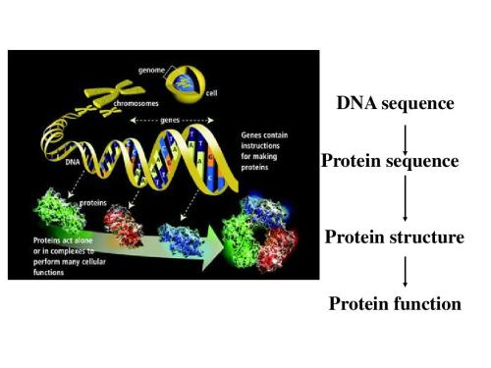
3. Soft condensed matter physics
Introduction
Computational physics
Research object：
Complex fluids, liquid crystals, multilayer films, protein folding
Research content:
Low-dimensional nanomaterials, etc.
Notes:
软凝聚态物理以复杂流体、液晶、多层膜、蛋白质的折叠等为研究对象。软凝聚态物理学的诞生，以法国著名物理学家P．G．de Gennes 1991年获得诺贝尔物理学奖为标志。当年，P．G．de Gennes提出软物质的概念，以后每年发表于各类物理学杂志的有关软物质的论文逐年增加。从此软物质研究作为物理学的一个重要研究方向得到了广泛的认可。
软物质是处于固体与理想流体的复杂态物质，软物质对于外界微小扰动的敏感性、非线性相应、自组织行为等特征，决定了此类物质与通常的固体、气体和液体大不相同。软物质具有流体热涨落和固态的约束共存的新行为。体现了其组成、结构和相互作用的复杂性和特殊性。软物质的丰富内涵和广泛的应用背景引起越来越多物理学家的兴趣，是具挑战性和迫切感的重要研究方向，已成为凝聚态物理研究的重要前沿领域。
软物质领域广阔、内容丰富，涉及几乎所有的现代探测手段，如：原子力显微镜、扫描近场光学显微镜、共聚焦显微镜、低温电镜、X射线、中子散射、单分子操纵与检测、荧光技术等等。目前，对其研究已从宏观水平深人到分子级水平，尤其对其结构和性质的研究已有很大进展。但是由于相应体系的极端复杂性，人们对于软物质的研究正方兴未艾。

Slide 35

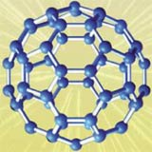

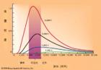
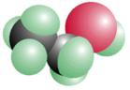
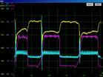
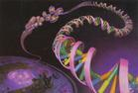
4. Atomic and Molecular Physics
Introduction
Computational physics
Atomic and Molecular Physics is the first research field in Computational physics
Notes:
Hyllerass利用变分计算精确求解He原子和H-、Li+、Be2+离子的定态薛定谔方程，得到He原子的电离能和H-离子的亲和能，和实验结果精确一致，验证了薛定谔方程在描述氢原子以外原子体系的正确性，从而也验证了量子力学在描述原子体系的正确性，对量子力学的发展起到了重要作用。从量子力学刚刚建立，人们就发展了变分、自洽场等数值计算方法，利用计算机研究原子分子的能级结构和定态之间的跃迁截面（矩阵元）。核武器的发展需要大量原子分子和光相互作用的截面数据和能级结构数据，极大的促进了计算原子分子物理的发展。以自洽场（类）为代表的能级结构和定态波函数的计算和以密耦合（close-coupling）（类）为代表的碰撞截面（跃迁矩阵元）的计算，直到二十世纪九十年代之前都是计算原子与分子物理的主要研究内容。虽然电子关联等基本问题还远没有获得解决，主要是通过微扰理论近似计算，但是这些理论模型和相关的数值计算方法，可以对整个元素周期表内的所有原子和各价离子基态和低激发态的能级结构和相关的跃迁截面给出基本正确的描述，产生了大量的原子分子数据，满足工程设计和相关基础研究（例如天体物理）的需要。这方面的主要代表性工作有Fisher和Grant[2]的非相对论及相对论的自洽场理论和计算软件（包含单组态和多组态的自洽场计算），Cowan[3]的著作和相关计算程序等等，还有以Seaton[4], Burke[5], Fano[6]为代表的多通道密耦合（multi-channel close-coupling）理论和相关计算程序等等，还有以Gaussian[7]系列版本为代表的商业软件。我国的研究，在这个发展阶段很少有重要的贡献

Slide 36
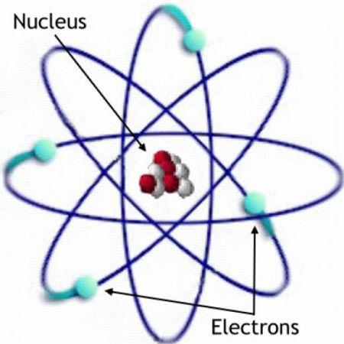
5. Nuclear physics
Introduction
Computational physics
Nuclear physics are complex :
1) the basic interactions involved;
2) the theoretical models involved;
3) the seldom and finite multibody problems;
4) the time involved And spatial scale span
Notes:
计算核物理在核科学技术发展中具有重要的战略地位。仅以核技术、核能发展对基础数据的需求为例。核数据在核能设施以及核武器的设计以及建造上具有极端重要的作用。一些重要的核结构、核反应数据无法通过实验直接测量，必须利用合适的理论模型计算得到。
计算核物理的特点与原子核的复杂性紧密相连，具体如下：1）涉及的基本相互作用多；2）涉及的理论模型多；3）涉及到少体和有限多体问题；4）涉及的时间和空间尺度跨度大。一定数目的核子结合起来形成一个原子核，强相互作用起主导作用；与分子间力——范德瓦尔斯力是电磁相互作用的剩余相互作用类似，核力主要是强相互作用的剩余相互作用。质子带电，所以质子之间存在电磁相互作用。原子核的 衰变等过程受弱相互作用支配。对于中子星等致密星体，引力至关重要。因此，在核物理研究中，需要考虑四种基本相互作用。

Slide 37
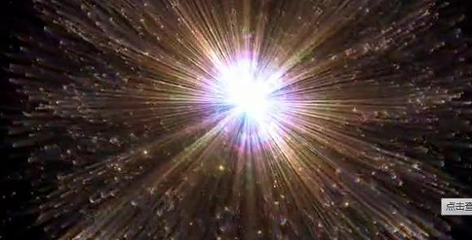
6. High energy physics
Introduction
Computational physics
Cutout calculation in quantum field theory
Large-scale numerical simulation of lattice quantum chromodynamics (grid QCD)
Notes:
量子场论中的圏图计算
包含多体末态的多圏图计算是当前的主要发展方向，它对从高能对撞实验数据中正确得到有效物理信息至关重要。
从形式上，圏图计算可分为解析计算和数值计算。早期由于处理的问题相对简单，大部分是做解析计算；随着所处理问题复杂度的上升，目前主流方法是解析计算辅助下做数值计算。
格点量子色动力学（格点QCD）的大规模数值模拟研究
格点QCD从严格意义上讲是QCD的一种正规化方案，在对四维时空的离散化后自然引入紫外截断，避免了微扰QCD方法中的紫外发散，也使QCD求解问题转化为具有近邻相互作用的多自由度系统的统计物理问题
格点QCD计算的系统误差大致来源于三个方面：第一是因时空离散化为四维时空格子带来的有限格距（相应于固体物理中的晶格常数）误差，这可以通过连续极限外推来控制；第二是四维时空格子的有限体积效应，可以通过增大格子体系来消除；第三是实际计算中的夸克质量参数对物理的夸克质量的偏离带来的系统误差，这可以通过手征外推来控制，或者直接用物理的夸克质量来计算。

Slide 38
7. Plasma is the fourth state of matter
Introduction
Computational physics
In nature, matter has four states:
Solid, liquid, gaseous and plasma
99% of the known matter in the universe is plasma.
The concept of plasma was established in the early 20th century: a system of macroscopic time and space scale composed of a large number of interacting charged particles.
Notes:
等离子体物理各个方向的发展，在国内外目前都处于比较快速的发展势态，包括大型实验装置建设、诊断和观测技术提升、等离子体工艺和技术的提高，由此人们对等离子体状态的超控能力、参数范围的拓展、物理过程的认识都在不断提高。这些能力的提升与人们对等离子体计算和模拟能力的提升是密不可分的。
作为物质的第四态，等离子体广泛存在于各类天体、星际和日地空间中。随着等离子体物理和技术的发展，人们不仅在实验室产生各种不同性质的等离子体，而且等离子体技术在工业、医疗、航天等领域获得了大量应用。事实上，等离子体物理和技术的研究具有很强的应用性，根据不同的应用目的和产生方法，等离子体可以大致分为磁约束聚变等离子体、惯性约束聚变等离子体、强激光及粒子束等离子体、空间等离子体、低温等离子体。等离子体物理和技术在能源、国家安全、航天等领域具有国家重大战略需求，在极端条件下的物态性质、新型粒子加速器、湍流产生和输运、非线性波粒子相互作用等方向是物理学的重要科学前沿。由于等离子体物理具有很强的应用背景，它与其他学科具有广泛交叉，譬如与光学、加速器物理、核物理、天体物理、空间科学、材料物理、化学、生物、医疗等其它学科广泛交叉。

Slide 39
Plasma classification:
Introduction
Computational physics
Magnetic confinement fusion plasma
Inertial confinement fusion plasma
Intense laser plasma
Space plasma
Low temperature plasma
Notes:
由于不同等离子体研究具有各自的特点，下面分别介绍磁约束聚变等离子体、惯性约束聚变等离子体、强激光等离子体、空间等离子体、低温等离子体各自的情况。

Slide 40
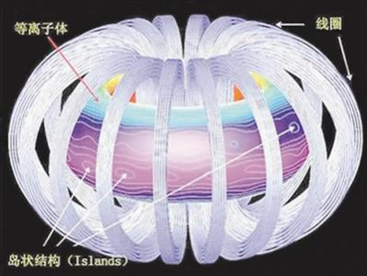
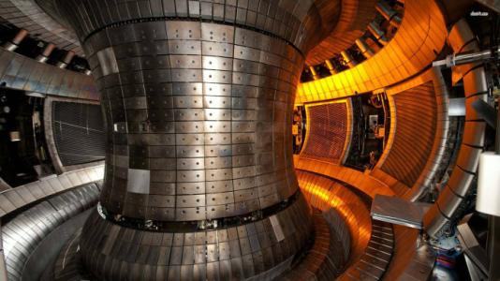
Magnetic confinement fusion plasma
Introduction
Computational physics
Physical numerical simulation:
Physical simulation
Base on First-order magnetic fluid (MHD) model or (cyclotron) kinetic model
Aim to understand the physical laws of plasma and methods of controlling plasma motion
Integrated simulation
Calculation and simulation of specific parameters of magnetic confinement fusion device
Understand physical processes, predict plasma behavior, and provide optimized parameters for test runs
Notes:
磁约束聚变等离子体
磁约束核聚变是国家能源科技的重大战略需求，在我国中长期科技规划中把ITER计划（国际热核实验反应堆计划）作为重点高技术国际合作项目积极参与，投入近百亿人民币进行研究和开发相关技术；并且在科技部成立国家磁约束聚变能源发展专项。随着ITER计划的进行[1]，我国正逐步掌握建造托卡马克实验装置的各项关键技术，近期科技部正在在规划部署自主研发我国自己的托卡马克实验装置CFETR。聚变实验装置造价极为昂贵（例如ITER耗资1000亿元），建设周期长（20年）；同时由于磁约束聚变等离子体物理的高度复杂性，其理论研究受到很大限制。因此，计算机模拟尤其是依托超级计算机的大规模数值模拟成为不可或缺的研究手段[2]；聚变等离子体模拟长期以来受到业内研究人员的大力推动，模拟成为继实验和理论之后又一重要研究工具，在聚变等离子体物理研究和工程研究上具有极为重要的战略地位，比如将来的ITER的实验方案就要求有强有力的模拟支持。一般各国磁约束聚变模拟和理论占整个磁约束聚变项目预算的10%左右，但我国现在远低于这个水平，还有很大上升空间。
磁约束核聚变等离子体物理模拟具有以下特点：1）所研究的对象具有复杂的平衡磁场结构，一般托卡马克是非圆截面带偏滤器位形的二维平衡，仿星器是更为复杂的三维平衡。2）所研究的物理具有多时空尺度特点，既有粒子回旋频率附近的射频波（纳秒时间尺度）加热，又有阿尔芬波和离子声波频率（微秒尺度）附近的湍流输运，还有更慢粒子碰撞时间尺度的新经典输运和等离子体破裂（秒尺度），并且这些物理过程对应的空间尺度相差近六个数量级。3）各种时空尺度的物理互相耦合演化，形成复杂的物理现象。4）等离子体物理是个多粒子体系，富含波-波，粒子-粒子以及波-粒子的非线性相互作用。
另外，磁约束聚变模拟具有很强的目的性，它主要是为实现长时间的可控核聚变和发展聚变能源而服务的。磁约束核聚变数值模拟要协助解决主要两方面的物理问题，稳态运行物理和燃烧等离子体物理。其中稳态运行物理主要关注湍流输运、等离子体破裂、射频波加热以及等离子体与器壁相互作用等关键物理。而燃烧等离子体物理主要研究在氘氚点火后产生大量高能a粒子（快粒子）对等离子体不稳定性和输运产生的影响和自持燃烧等关键物理。

Slide 41
Magnetic confinement fusion plasma
Introduction
Computational physics
Physical simulation features:
The object of the study has a complex balanced magnetic field structure.
The physics studied has multiple temporal and spatial scale characteristics.
Physical mutual coupling evolution of various temporal and spatial scales.
Plasma physics is a multi-particle system , including wave-wave, particle-particle and wave-particle nonlinear interactions.
Notes:
磁约束核聚变等离子体物理模拟具有以下特点：1）所研究的对象具有复杂的平衡磁场结构，一般托卡马克是非圆截面带偏滤器位形的二维平衡，仿星器是更为复杂的三维平衡。2）所研究的物理具有多时空尺度特点，既有粒子回旋频率附近的射频波（纳秒时间尺度）加热，又有阿尔芬波和离子声波频率（微秒尺度）附近的湍流输运，还有更慢粒子碰撞时间尺度的新经典输运和等离子体破裂（秒尺度），并且这些物理过程对应的空间尺度相差近六个数量级。3）各种时空尺度的物理互相耦合演化，形成复杂的物理现象。4）等离子体物理是个多粒子体系，富含波-波，粒子-粒子以及波-粒子的非线性相互作用。
另外，磁约束聚变模拟具有很强的目的性，它主要是为实现长时间的可控核聚变和发展聚变能源而服务的。磁约束核聚变数值模拟要协助解决主要两方面的物理问题，稳态运行物理和燃烧等离子体物理。其中稳态运行物理主要关注湍流输运、等离子体破裂、射频波加热以及等离子体与器壁相互作用等关键物理。而燃烧等离子体物理主要研究在氘氚点火后产生大量高能a粒子（快粒子）对等离子体不稳定性和输运产生的影响和自持燃烧等关键物理。

Slide 42
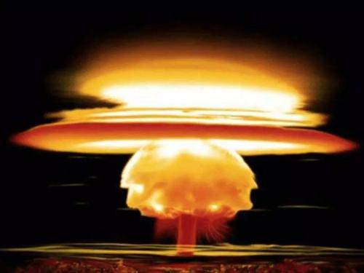
Inertial confinement fusion(ICF)plasma
Introduction
Computational physics
Divided by drive type that the energy is loaded into the fusion target: Laser drive Z pinch drive heavy ion beam drive
Divided by ignition method: Center ignition Body ignition Fast ignition
ICF can be used to build a fusion power station to provide the society with controlled thermonuclear fusion new energy.
Notes:
惯性约束聚变等离子体
惯性约束聚变(ICF)是不同于磁约束聚变的实现受控核聚变的另一主要途径[3-6]。在ICF中，某种形式的能量直接或间接地加载到装有氘氚聚变燃料的球形靶丸，将其加速后以相当高的速度聚心内爆。在球几何收缩作用下，氘氚聚变燃料被高度压缩、并加热至核聚变燃烧状态，在惯性约束作用下，氘氚聚变维持一段时间，释放出可观的热核聚变能。
按照能量加载到聚变靶的驱动器类型划分，ICF可以分为激光驱动、Z箍缩驱动、重离子束驱动等。激光驱动有三种方式。第一种为直接驱动，激光束直接照射氘氚靶丸表面驱动其内爆，这种方式具有较高的激光能量利用效率，但是要求激光照射的不均匀度小于~1%-2%。第二种方式为间接驱动，激光束照射到包围靶丸的黑腔内壁产生X光辐射，X光输运至靶丸表面驱动靶丸内爆。第三种为间接—直接混合驱动。除激光外，也可以用离子束作驱动源，离子束先轰击围绕靶丸的物质，转换为X射线，实现间接驱动ICF。按照点火方式分，ICF可以分为中心点火、体点火、快点火等。在中心点火方式中，首先将靶丸中心部分的氘氚燃料压缩、加热至点火条件，形成点火热斑，热斑聚变燃烧，加热并点燃周围高度压缩的氘氚聚变燃料。在体点火方式中，整个聚变燃料区一起被压缩加热至点火条件。快点火方式将氘氚燃料的压缩与点火过程分开，即先对氘氚燃料进行压缩，再通过超强超短激光创建点火热斑，形成燃烧。重离子束驱动是用强流高能重离子束代替激光束，实现对聚变靶丸的加热和压缩。Z箍缩驱动是通过脉冲功率技术，将驱动器的电储能高效地转换为负载等离子体动能或X光辐射能，实现对聚变靶丸的加热和压缩，主要包括两种技术途径。一种是利用Z箍缩内爆产生的强辐射形成黑腔，利用黑腔辐射场辐射驱动靶丸内爆，主要构型包括动态黑腔和双Z箍缩黑腔。另一种是磁化套筒惯性聚变(MagLIF)，即利用Z箍缩柱形套筒内爆压缩柱形DT燃料实现聚变点火，通过激光对燃料进行预热降低内爆收缩比，利用初始磁场对燃料磁化减小热传导损失并增加a离子能量沉积。
在中心点火方式中，首先将靶丸中心部分的氘氚燃料压缩、加热至点火条件，形成点火热斑，热斑聚变燃烧，加热并点燃周围高度压缩的氘氚聚变燃料。在体点火方式中，整个聚变燃料区一起被压缩加热至点火条件。快点火方式将氘氚燃料的压缩与点火过程分开，即先对氘氚燃料进行压缩，再通过超强超短激光创建点火热斑，形成燃烧。

Slide 43
Four characteristics of ICF numerical simulation:
Introduction
Computational physics
2D and 3D computing power tends to be strong
Physical modeling tends to be refined
The credibility of the calculation results is significantly improved
Large-scale, high-performance parallel computing capabilities are rapidly improving
Notes:
（1）二维和三维计算能力趋于强大。早期的LASNEX程序只有二维模拟能力，并且在应用至流体大变形和多尺度问题时模拟能力受限。而HYDRA程序结合ICF特点大力发展了ALE模拟技术，克服了上述难点。1998年，HYDRA程序首次实现了点火靶三维内爆性能评估。2001年，该程序给出了BeCu点火靶的腔—靶耦合三维模拟。2004年，该程序实现了辐射脉冲整形的自动化，用来扫描靶内爆性能在不同参数空间的内爆性能。紧接着，2005年，Haan等人发表文章采用该程序进行大规模参数扫描，优化点火靶设计的健壮性。在2007年IFSA会议上，Hammel等人报道了HYDRA模拟BeCu靶丸内爆二维和三维高阶不稳定性扰动模，模数达到了2000。在2009年IFSA会议上，Clark等人采用该程序模拟CH靶丸1D和2D内爆性能，2D多模模拟的已经可以达到1-30或者2-60阶扰动模，并给出了Bump缺陷的二维模拟。在2009-2012 NIC点火攻关期间，HYDRA程序更是大量用于分析NIF点火实验。为了分析NIC低熵靶内爆性能低的原因，HYDRA程序更是实现了热斑混合、驱动不对称性、注入孔、夹持膜和靶丸粗糙度等因素的二维和三维综合模拟。
（2）物理建模趋于精细化。辐射不透明度是ICF黑腔和靶丸计算的重要物理参数，LLNL早期采用平均原子模型计算辐射不透明度参数，2011年NIF装置兆焦耳级别黑腔能量学实验发现模拟程序低估了黑腔辐射能流，并提出了高流模型。在高流模型中，当温度高于300 eV时采用非局域热动平衡（NLTE）的细致组态模型（DCA）来计算辐射不透明度参数，当温度低于该值时仍然采用平均原子模型；同时，高流模型还增大了电子热传导的限流系数。最近，NIF实验显示采用高流模型可能高估了黑腔辐射能流，需要在高流模型中降低LTE至NLTE的转换温度。状态方程也是ICF的重要参数，LLNL早期采用的是QEOS模型，研究发现状态方程对不稳定性计算的影响很大，同时QEOS会低估DT的压缩，因此LLNL在QEOS的基础上进行修正建立了多个版本的LEOS，比如CH烧蚀材料有LEOS 5105、LEOS5310等。
（3）计算结果的置信度显著提高。NIF装置针对ICF建立了多个实验平台，包括Reemit(铋球再发射)、Keyhole（锁孔靶）、Backlit Capusle（靶丸背光成像）、Symmetry Capsule（靶球对称性调控）、Cryo-Layered Capsule（冷冻分层靶）、Hydrodynamic Growth Radiography（不稳定性增长X光成像）等，这些实验平台上的各种分解及综合实验为模拟程序置信度提高提供了宝贵的实验数据。HYDRA程序经过完善之后，置信度大幅度提高，在考虑混合效应、驱动不对称性、靶丸夹持膜、燃料注入孔、三维效应等综合因素时，低熵内爆靶模拟得到的中子产额与实验结果的差距由原来的100倍缩小至0.5倍。不稳定性增长X光成像平台实验结果还表明HYDRA程序关于流体力学不稳定性增长的二维和三维模拟是可靠的。
（4）大规模、高性能并行计算能力迅速提升。事实上，在高性能数值模拟方面，美国一直是这方面的引领者，从上个世纪四、五十年代起，美国利弗莫尔和洛斯阿拉莫斯国家实验室就非常重视高性能科学计算，五十年代建立了IBM超级计算机，六、七十年代建立了CDC计算平台，八十年代建立了Cray计算平台。七十年代末，美国能源部在利弗莫尔国家实验室建立了NERSC中心，并向能源部的所有能源研究开放。与此同时，日本和欧洲也开始有能力建造超级计算机。逐渐地，计算物理和计算科学逐渐成为研究热点。目前，在世界TOP500超级计算机中，美国有201台、将近40%，欧洲有107台，中国有109台。美国ICF应用程序都经过高规格的性能优化,在大规模、高性能并行计算能力的支撑下，其HYDRA程序辐射流体力学模拟二维计算网格规模可达约50万，三维计算网格规模达到4亿，扰动模数均分辨至100。这些大规模模拟给出了许多新的物理认识。

Slide 44

Intense laser plasma
Introduction
Computational physics
The feature of intense laser plasma
complexity of physical processes
ultra-fine aspects of physical processes in time and space.
Our weapon:
Ultra-large scale numerical simulation
Notes:
激光等离子体加速的发展离不开计算机模拟，而本领域计算机模拟的发展也是随着超短超强激光技术的发展逐步向着物理过程更为丰富、复杂，计算量更为庞大方面发展。现在，激光等离子体无论是在物理过程的复杂性，还是物理过程在时间空间上的超精细方面，也都进入了前所未有的高度，此时实验研究将更显得不足；而通常的粒子模拟也将难以胜任。这些超大规模的数值模拟研究，将大大加深我们对极强相对论激光等离子体加速的认识，为该领域的快速发展提供便捷直观的研究工具。
除了超短超强激光以及计算机硬件的发展，针对这些新型物理过程的数值计算软件的发展，也必须紧随其后。这包括两个方面，一是新出现的物理过程必须包括；二是针对新物理过程的，高效能的计算方法必须应运而生。可以说，本领域的计算物理学科的发展，也必将与超短超强激光技术的发展一样，在硬件和软件两方面与其同步，对超短超强激光等离子体加速的研究起到不可或缺的作用。

Slide 45
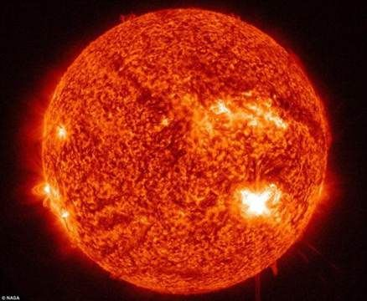
Space plasma:
Introduction
Computational physics
At present, the study of solar plasma in the atmosphere is based on numerical simulation of magneto hydrodynamics.
Including:
large-scale plasma physics processes
small-scale dynamic processes(more attention)
Our weapon:
combines particle simulations of large-scale dynamic processes with large-scale physical processes.
Notes:
4.空间等离子体
目前，对局地的基本物理过程的研究手段主要是粒子模拟，而对这些物理过程的全球效应的研究主要通过磁流体力学的数值模拟进行。
同样的这些大尺度的等离子体物理过程同样是由小尺度的动力学过程驱动的，并且随着卫星观测的分辨率的提高，对太阳大气中发生的小尺度动力学过程也越来越关注。这也对既能模拟小尺度动力学过程又能模拟大尺度物理过程的数值模拟方法提出了要求。
计算空间等离子体物理的趋势是发展结合研究小尺度动力学过程的粒子模拟和大尺度物理过程的磁流体力学数值模拟的方法。

Slide 46
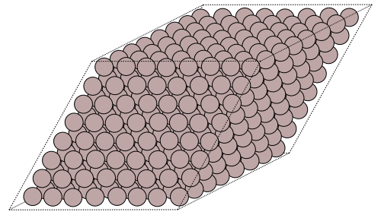
Low temperature plasma
Introduction
Computational physics
(1) Prediction and analysis of the chemical kinetics of low temperature plasma components.
(2) Numerical simulation of low temperature plasma processes across time and space scales.
(3) Calculation of low temperature plasma instability prediction and dynamic evolution process.
(4) Combine with high performance calculation to improve the numerical calculation ability of low temperature plasma.
(5) Basic data research of low temperature plasma.
Notes:
5.低温等离子体
低温等离子体技术的发展在某种意义上可以看作人类能源利用方式与水平的拓展和提高。每一次重大进步和发展都建立在对低温等离子体物理科学认识和理解的基础上。从科学研究的角度考虑，只有通过理论分析、数值模拟、实验诊断三者相结合的方法，才能对低温等离子体过程进行系统地分析，揭示放电参数对等离子体状态参数的影响规律。从实际应用的角度考虑，需要通过数值模拟或仿真，为放电装置研制提供优化指导，对工艺过程进行预测，缩短低温等离子体装置研制或工艺过程的研发周期。然而当前相当一部分低温等离子体计算与模拟还只停留在模型验证阶段，分析和预测能力不足。应用中存在的问题推动相关研究的发展，当前世界范围内研究热点的演化反映了计算低温等离子体物理的发展规律和态势。
低温等离子体物理和技术的发展是与等离子体的广泛应用密不可分的。从传统的航空航天、材料加工，延伸到微电子、新材料制备、生物医学与新能源等领域[14,15]，低温等离子体的技术和商业价值得到了迅速发展。如果没有低温等离子体技术及其带来的新应用，现代社会科学与经济发展会受到很大影响。过去低温等离子体只是单纯地被作为能量形式转化的载体，而今其丰富组分所带来的化学活性、多样性、灵活性、环境友好等特性引起了学术界和工业界的广泛关注[16]，因而正处于二十一世纪科学与技术革命的前沿。
（1）预测与分析低温等离子体组分化学动力学过程。
（2）跨时空尺度的低温等离子体过程数值模拟。
（3）低温等离子体不稳定性预测和动态演化过程的计算模拟。
（4）与高性能计算结合提升低温等离子体数值计算能力。
（5）低温等离子体基本数据研究。

